Slide 1
Where We Are in Place and Time
Allyson Eno
Unit designed using
The Brain Based Teaching Model (Hardiman, 2003)

Slide 2
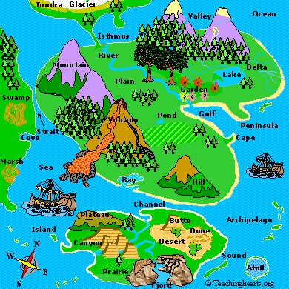
Background Information
First Grade Unit
Duration: 5 weeks
Primary Years Programme Curriculum
(PYP)
Unit under the Transdiciplinary Theme:
Where We Are in Place and Time
Central Idea:
The Earth is made up of landforms that change over time
Note: The PYP is a concept and skills based curriculum. The idea being that by teaching students skills and concepts that they can apply these to other areas of their life- throughout their lives, creating life long learners

Slide 3
Brain Target 1- setting the emotional climate for learning
  Key Points Utilized in This Unit:
  Have set routines and procedures in place- take away uncertainty
  Give students choices in their learning- what they want to study and how they want to present their new skills and knowledge
  Celebrate successes and reward risk-taking

Slide 4
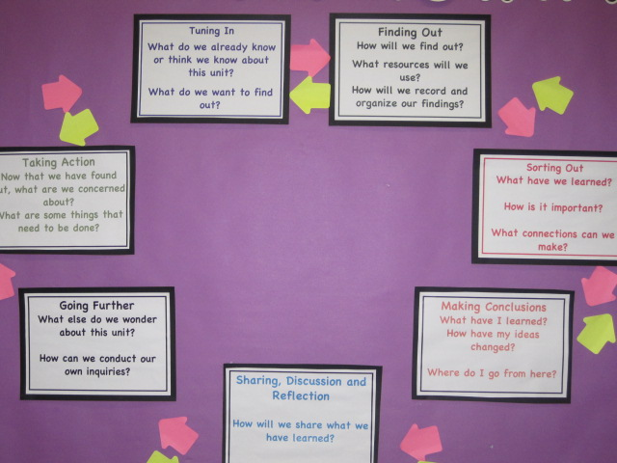
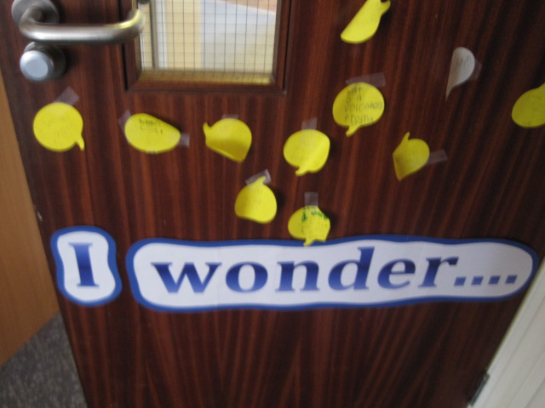
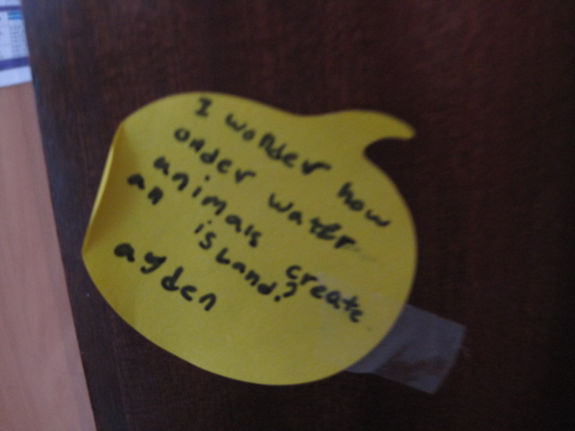
Maintaining established routines- for consistency and predictability
Each unit we use Kath Murdoch’s inquiry cycle- this established routine allows for continuity and structure as we conduct our inquiries.
At the beginning of the unit Students generate questions to put on our Unit of Inquiry board.
Any questions that they have as the unit continues- they post these questions on our I Wonder Spot….

Slide 5
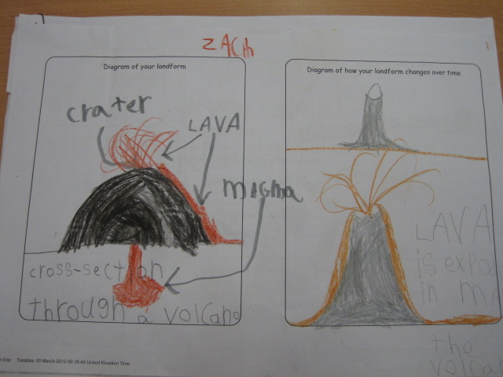
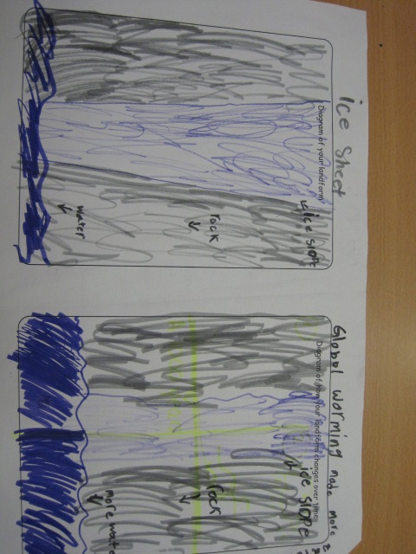
Choice
This unit is filled with choice- choice on what landforms to study, choice on how to present information and what facts to present.
This empowers students and gives them ownership over their learning.

Slide 6
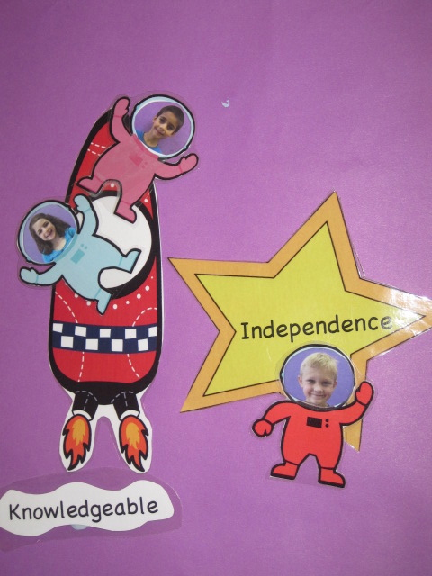
Celebrating Success
Students move their image when they have demonstrated the Learner Profile or Attribute that we are focusing on during the current unit.
In this unit we are focusing on becoming more knowledgeable through research skills as well as being independent.

Slide 7
Brain Target 2- creating the physical learning environment
Key Points Utilized in This Unit :
  Keep novelty and interest with classroom displays
  Use music to calm and relax while working and during transition times

Slide 8
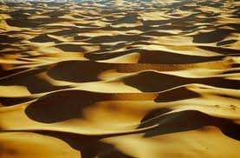
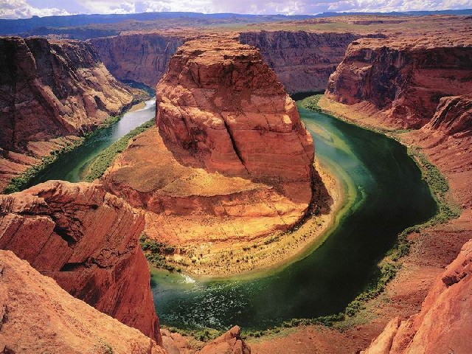
I see, I think, I wonder Visible Thinking routine-
This Visible Thinking routine display is changed on a weekly basis. This allows for novelty while inquiring into landforms. We used this routine at the start of every week to explore Deserts, Coasts, Volcanoes and Canyons.

Slide 9
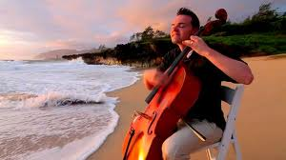
Transition Meditations
To ready ourselves for learning students participate in meditation and relaxation routines that correspond with our landforms unit.
Students watched a variety of time-lapse photography landform videos as well as The Piano Guys YouTube videos- that include a variety or landforms for their backdrops.
These meditations then led to a variety of discussions based on what they observed
The Piano Guys:
http://www.youtube.com/watch?v=jzF_y039slk

Slide 10
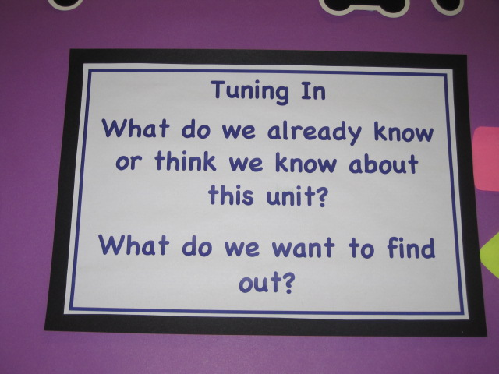
Brain Target 3- Designing the Learning Experience
Key Points Utilized in This Unit:
  The PYP uses a “Backward by Design” model for planning- or planning with the end in mind- what children will walk away with
  Allow students to see the Big Picture- the main idea of the unit

Slide 11
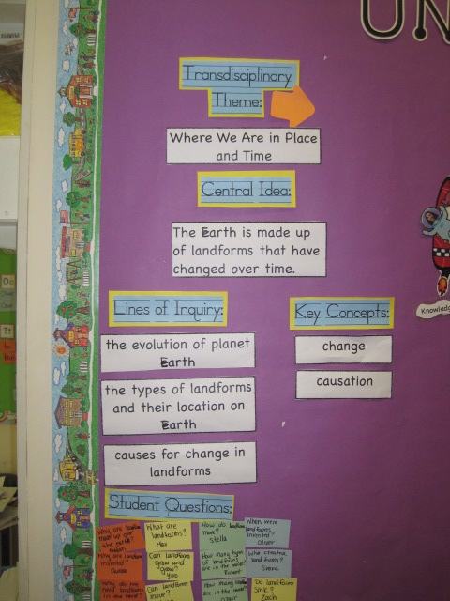
What’s the BIG idea?
Central Idea: The Earth is made up of landforms that have changed over time
As part of our Tuning In process we discuss the central idea, what we already know and “unpack” any words that might cause confusion. Without explicitly giving them information.
We discuss the key concepts- Change and Causation and review the skills we will be working on in this unit- Research skills.

Slide 12
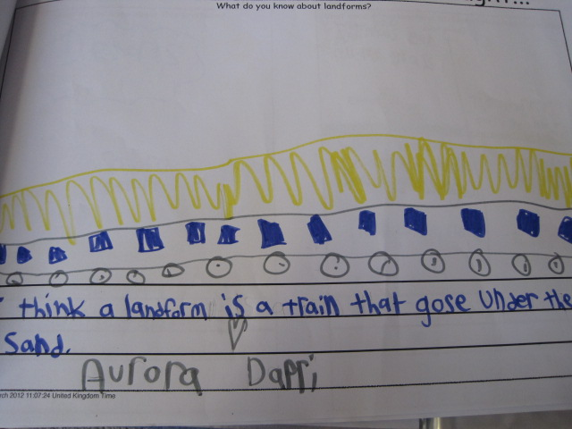
Big Picture Activity
Students wrote what they thought a landform was as a pre-assessment before we researched the answer together as a class. This gave me an idea of the students prior knowledge as we began the unit.

Slide 13
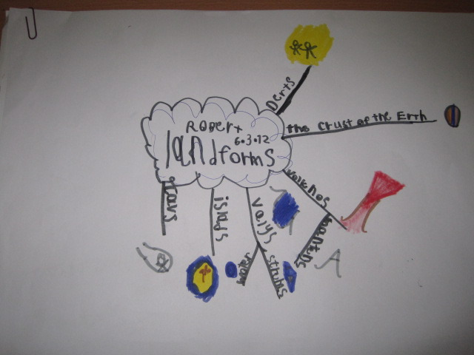
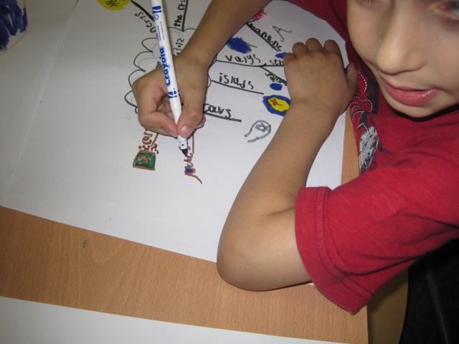
Mind Maps
At the start of the unit students began a mind map. As they researched landforms they added the information they had learned to mind maps.
The mind maps were added to until the completion of the unit as a way to organize their new knowledge and thinking.

Slide 14
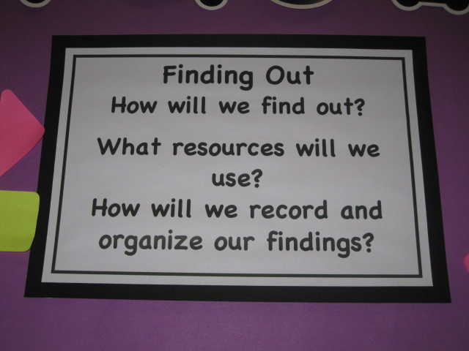
Brain Target 4- Teaching for Declarative and Procedural Knowledge
Key Points Utilized in This Unit:
  Tapping into students emotions
  Accessing prior knowledge
  Repeated rehearsals
  Using novel ways to present information

Slide 15
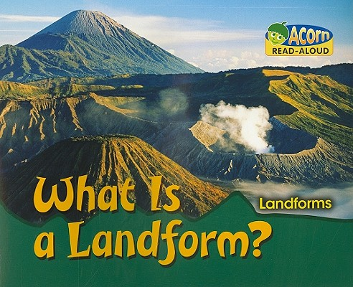
Lines of Inquiry (learning objectives)
During this unit students will inquire into:
  The evolution of planet Earth
  Types of landforms and their location on Earth
  Causes for change in landforms

Slide 16
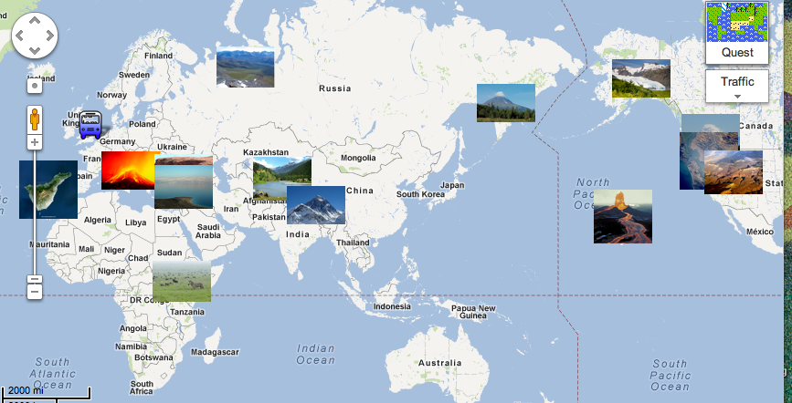
Prior Knowledge and Emotion
In class students participated in a Think-Pair-Share to discuss landforms found in their home countries
Students were then asked to research a specific landform from their home country for homework.
We then displayed the information in the classroom as well as created a Google map that we continued to add to as the unit progressed.

Slide 17
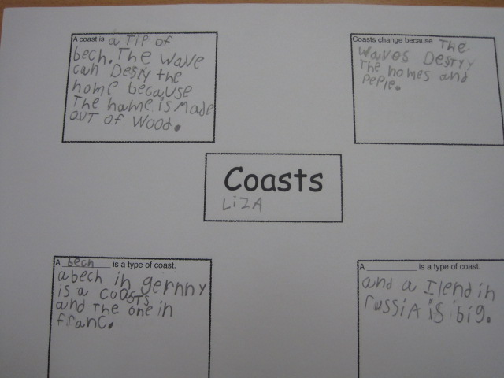
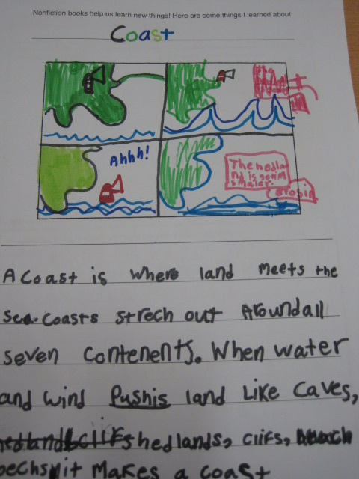
Research Skills/Repeated Rehearsals
Research skills:
  Gathering Information
  Organizing Information
  Presenting Information
Students participated in 2 guided inquiries to develop their researching skills and then an independent inquiry- taking these skills and applying them.
  This allowed for repeated rehearsals throughout the course of the unit of inquiry

Slide 18
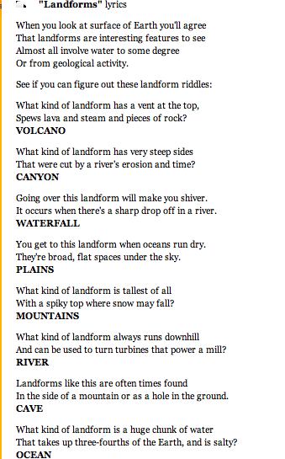
Novelty: Landforms Set to Music
Adding a bit of fun and flare to our research we found a song that we sang every day- the repeated usage allowed for students to have automatic recall about a variety of landforms- even those we didn’t research.
To listen to the song click here:
http://www.totally3rdgrade.com/landforms.html

Slide 19
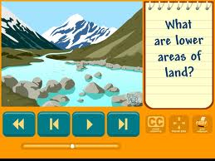
Novelty: Landform Videos
Students watched videos from brainpopjr.com as well as brainpop.com to inquire into:
  types of landforms
  Pangaea
  changes in the Earth’s surface
Students also watched time lapse photography that allowed them to see changes in landforms over time.
http://www.brainpopjr.com/
http://www.brainpop.com/

Slide 20
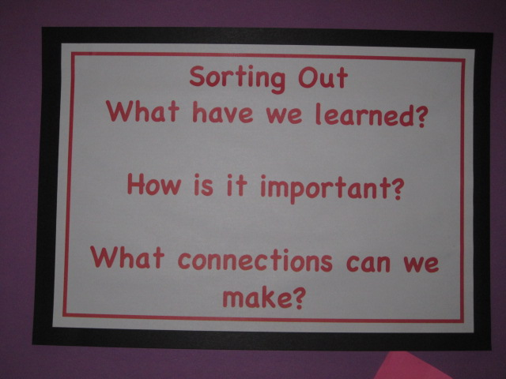
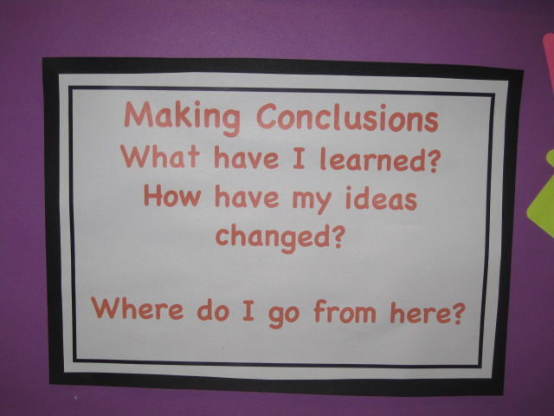
Brain Target 5- Teaching for Extension and Application of Knowledge
Key Points Utilized in This Unit:
  Creative thinking through visual media
  Conducting Experiments

Slide 21
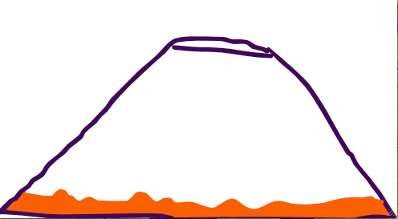
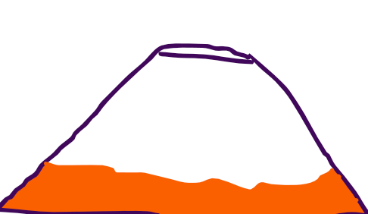
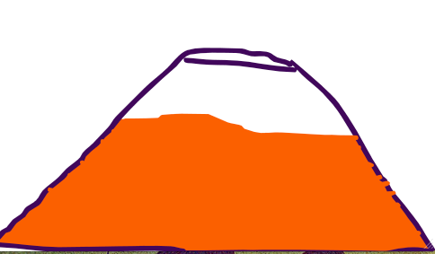
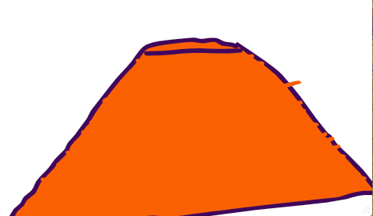
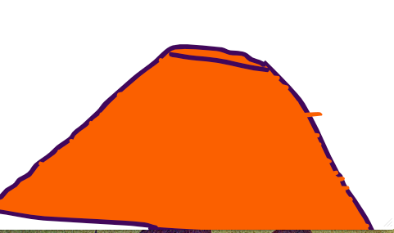
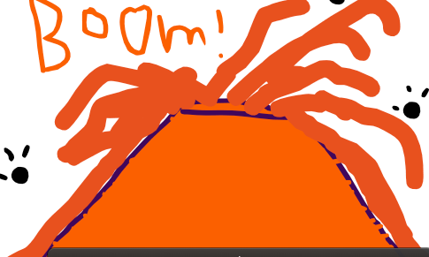
Creating Animations
Students used Animation-ish to create animations of the landforms they researched independently. Students used their knowledge of the concept of change to create animations that illustrate how their landform changes over time.
Volcano Animation: below are screen shots of an animation created to illustrate a volcanic eruption.

Slide 22



Creating Animations
Students used Animation-ish to create animations of the landforms they researched independently. Students used their knowledge of the concept of change to create animations that illustrate how their landform changes over time.
Canyon Animation: below are screen shots of an animation created to illustrate how the Colorado River helped to create the Grand Canyon over time.

Slide 23
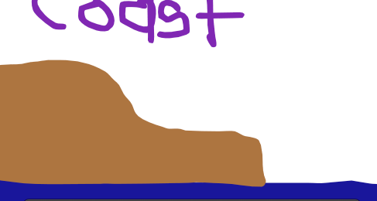
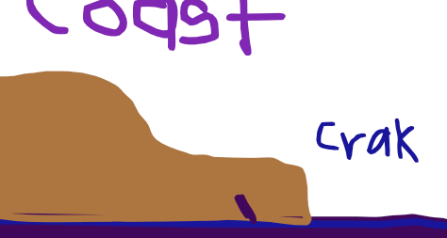
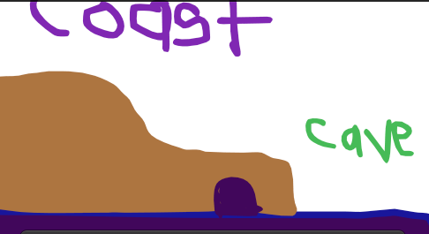
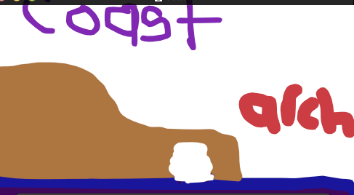
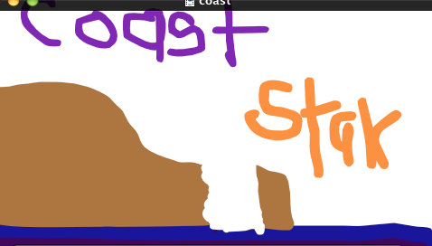
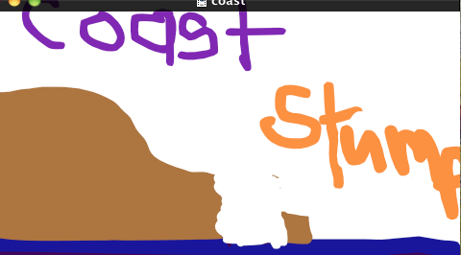
Creating Animations
Students used Animation-ish to create animations of the landforms they researched independently. Students used their knowledge of the concept of change to create animations that illustrate how their landform changes over time.
Coast Animation- below are screen shots of an animation created to illustrate the erosion of a headland.

Slide 24
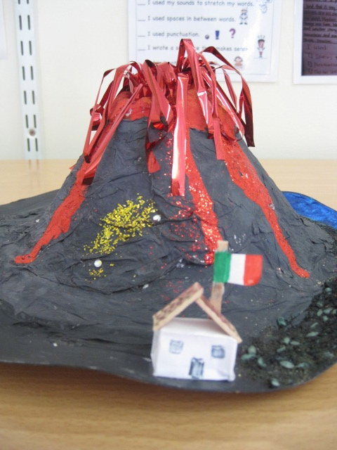
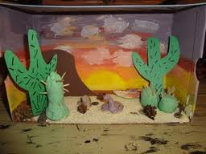
Models and Dioramas
Students could also choose to create a model of their landform to display their understandings.
One of the Italian students made a model of Mt. Vesuvius complete with a Pompeii house!
Some students chose to make a diorama, similar to the one shown here. Note: This isn’t an example from my class- mine had been taken home before I could snap a picture!

Slide 25
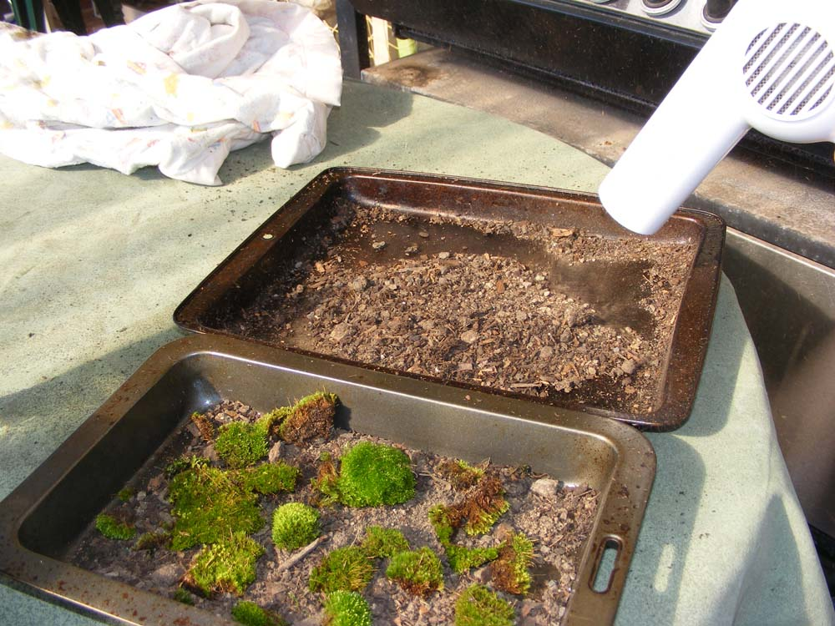
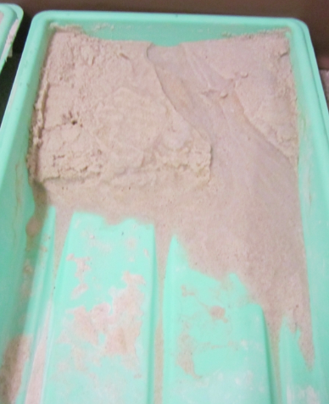
Experiments
Students participated in a variety of erosion experiments to illustrate the effects of wind and water on landforms over time.
Creating Sand Dunes- using a straw and a hair dryer to blow sand to form dunes.
Costal Erosion- creating waves to wash sand away from cliffs and beaches
Canyon Erosion- using slow and fast running water to create a canyon through sand

Slide 26
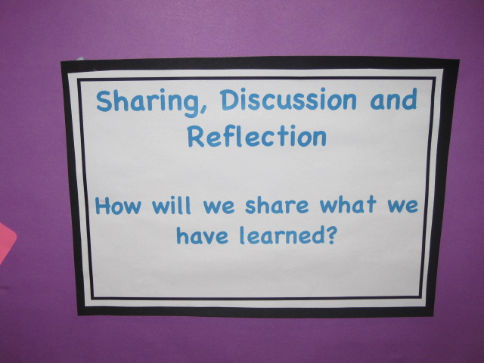
Brain Target 6- Evaluating Learning
Key Points Utilized in This Unit:
  Prompt feedback throughout the learning engagements
  Performance Based Assessment

Slide 27
Ongoing and frequent feedback
The guided inquiries students participated in allow immediate feedback regarding gathering, organizing and recording data (research skills)
Throughout the unit, students analyzed their own work as well as peer reviewed their friends to give feedback after each draft.

Slide 28
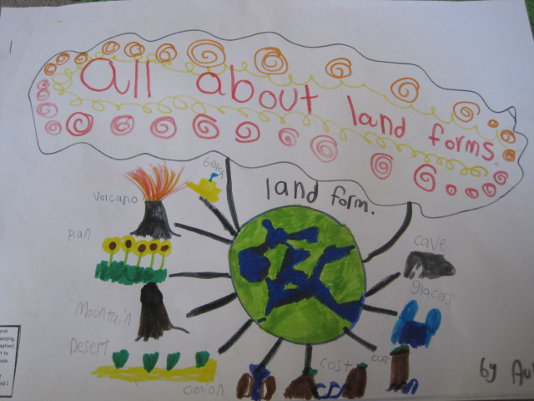
Writing Our Own Non-Fiction Texts
Showing What We Know
Students created a non-fiction book to demonstrate their ability to use the newly acquired research skills independently as well as their understanding of the lines of inquiry.
Note: The structure was established for them (as this was our first go at a non-fiction book) but the content and aesthetic was up to them!

Slide 29
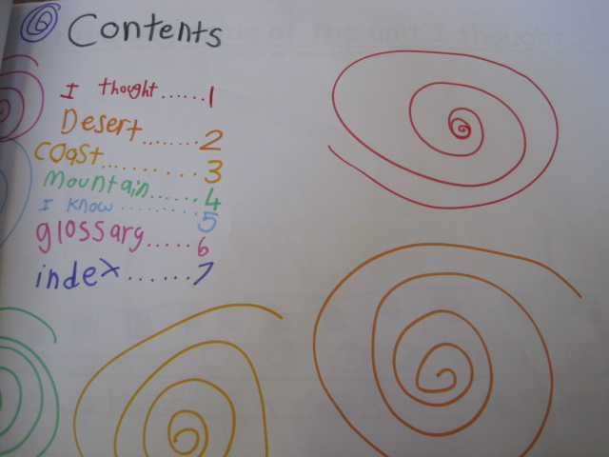
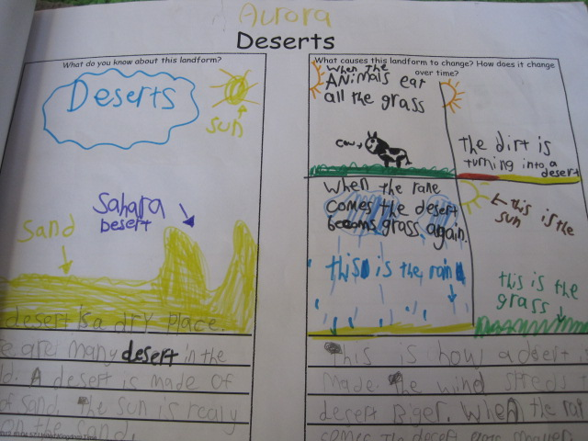
landform non-fiction book

Slide 30
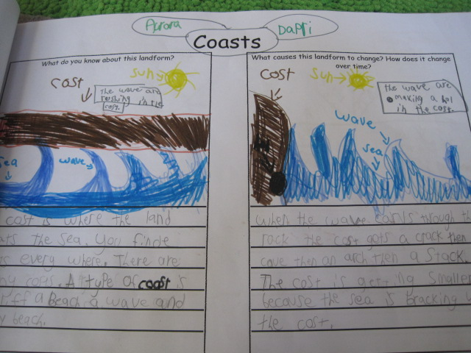
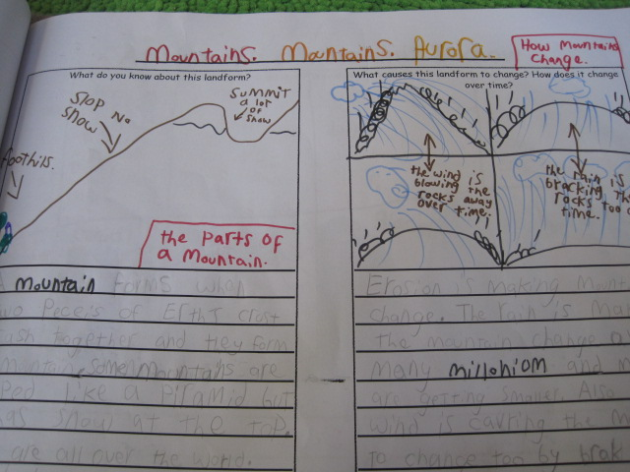
landform non-fiction book

Slide 31
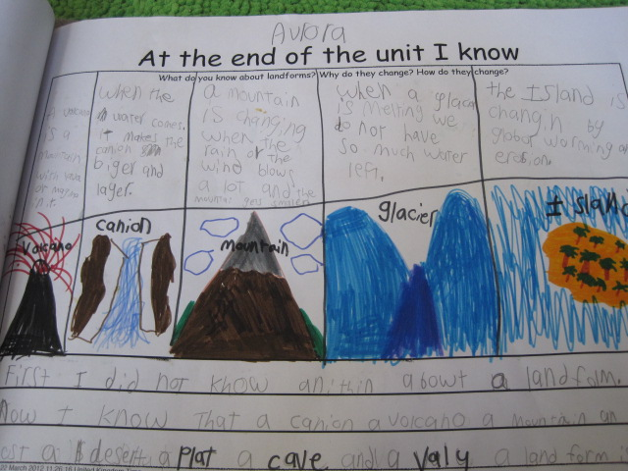
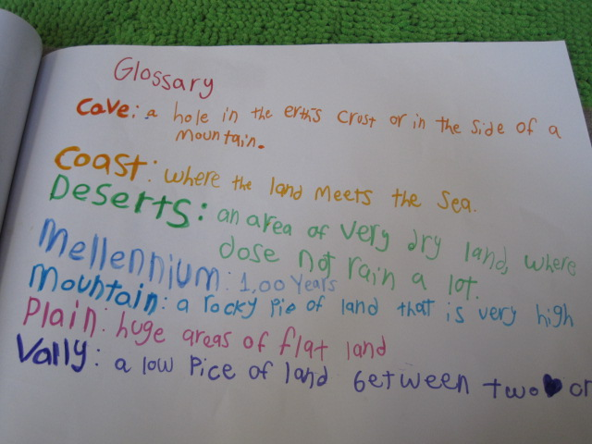
landform non-fiction book

Slide 32
References
Hardiman, Mariale M. (2003). Connecting brain research with effective teaching. Lanham, Maryland: Rowman & Littlefield Publishers.
Murdoch, Kath. (1999). Classroom connections: Strategies for integrated learning. Pennsylvania State University: Eleanor Curtain Publishing.

